Slide 1
Introduction to Routing and Packet Forwarding

Slide 2
What is Routing?
Routing Means : Selecting the Best Path
How could you select the Best Path ?
  Statically
  Dynamically

Slide 3
Routing Table Structure
Routing Table is stored in ram and contains information about:
  Directly connected networks - this occurs when a device is connected to another router interface
  Remotely connected networks - this is a network that is not directly connected to a particular router
  Detailed information about the networks include source of information, network address & subnet mask, and Ip address of next-hop router
Show ip route command is used to view a routing table

Slide 4
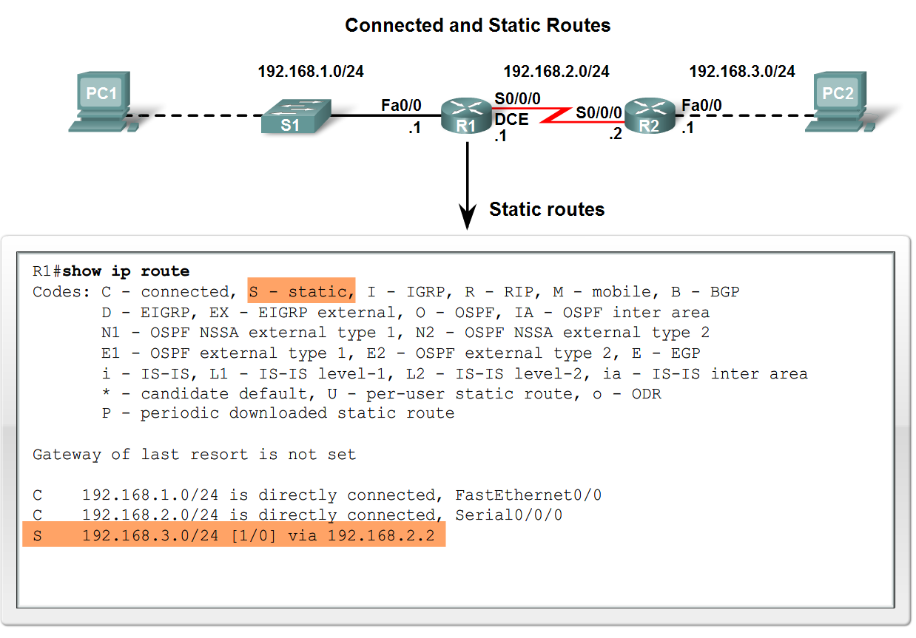
Routing Table Structure
Adding a connected network to the routing table
  -Router interfaces
    Each router interface is a member of a different network
    Activated using the no shutdown command
    In order for static and dynamic routes to exist in routing table you must have directly connected networks

Slide 5
Routing Table Structure
Static routes in the routing table
  -Includes: network address and subnet mask and IP address of next hop router or exit interface
  -Denoted with the code S in the routing table
  -Routing tables must contain directly connected networks used to connect remote networks before static or dynamic routing can be used
When to use static routes
  -When network only consists of a few routers
  -Network is connected to internet only through one ISP
  -Hub & spoke topology is used on a large network

Slide 6
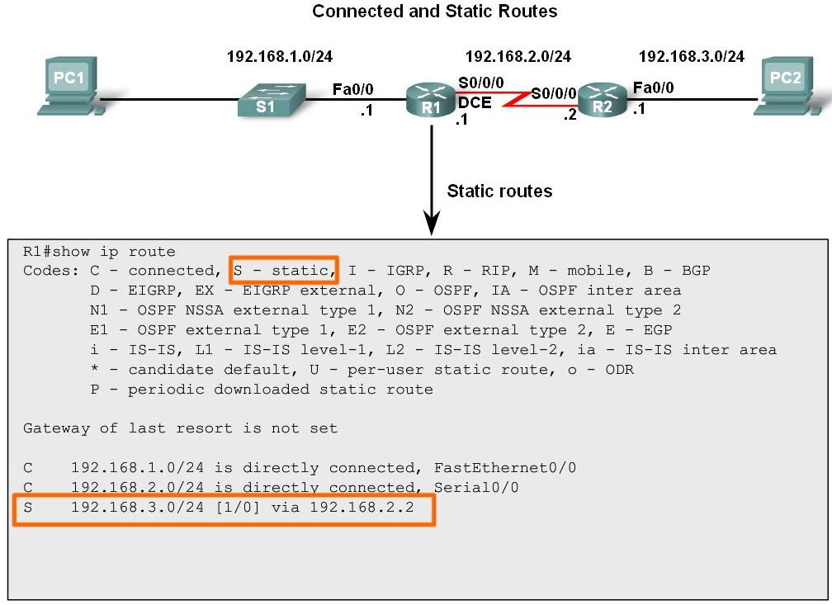
Routing Table Structure
Connected and Static routes

Slide 7
Routing Table Structure
Dynamic routing protocols
  -Used to add remote networks to a routing table
  -Are used to discover networks
  -Are used to update and maintain routing tables
Automatic network discovery
  -Routers are able discover new networks by sharing routing table information

Slide 8
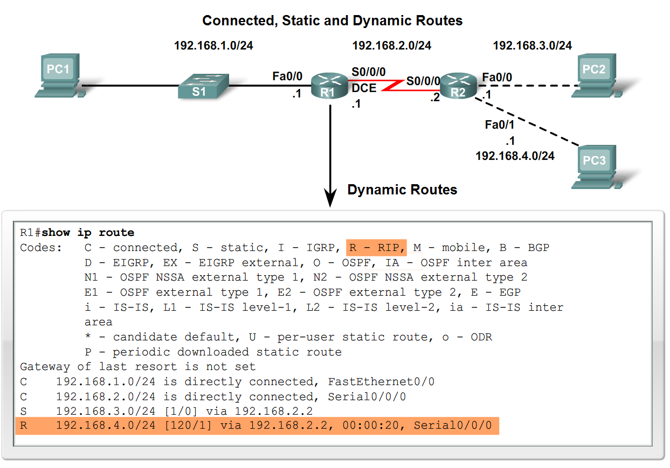
Routing Table Structure
Maintaining routing tables
  -Dynamic routing protocols are used to share routing information with other router & to maintain and up date their own routing table.
IP routing protocols. Example of routing protocols include:
  -RIP
  -IGRP
  -EIGRP
  -OSPF
  -IS-IS
  -BGP

Slide 9
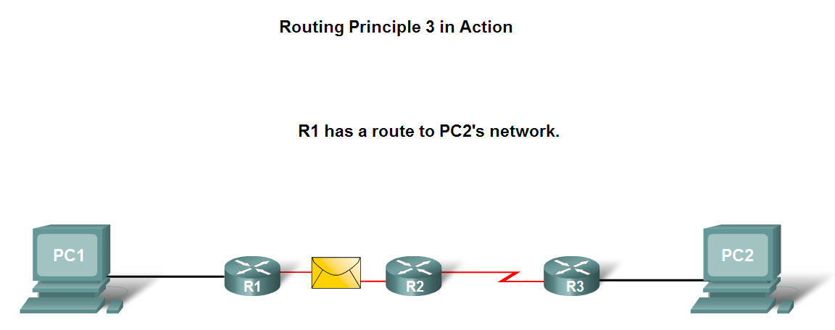
Routing Table Structure
Routing Table Principles
  -3 principles regarding routing tables:
    Every router makes its decisions alone, based on the information it has in its routing table.
    Different routing table may contain different information
    A routing table can tell how to get to a destination but not how to get back

Slide 10
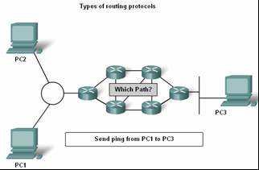
Routing Table Structure
Effects of the 3 Routing Table Principles
    -Packets are forwarded through the network from one router to another, on a hop by hop basis.
    -Packets can take path “X” to a destination but return via path “Y” (Asymmetric routing).

Slide 11
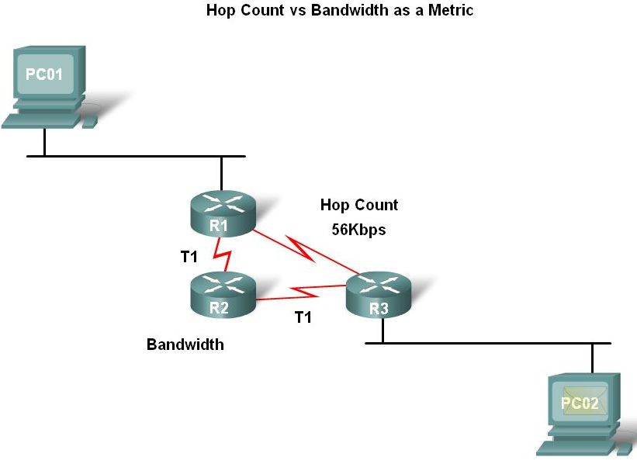
Router Paths and Packet Switching
A Metric is a numerical value used by routing protocols help determine the best path to a destination
  The smaller the metric value the better the path
2 types of metrics used by routing protocols are:
  -Hop count - this is the number of routers a packet must travel through to get to its destination
  -Bandwidth - this is the “speed” of a link also known as the data capacity of a link

Slide 12
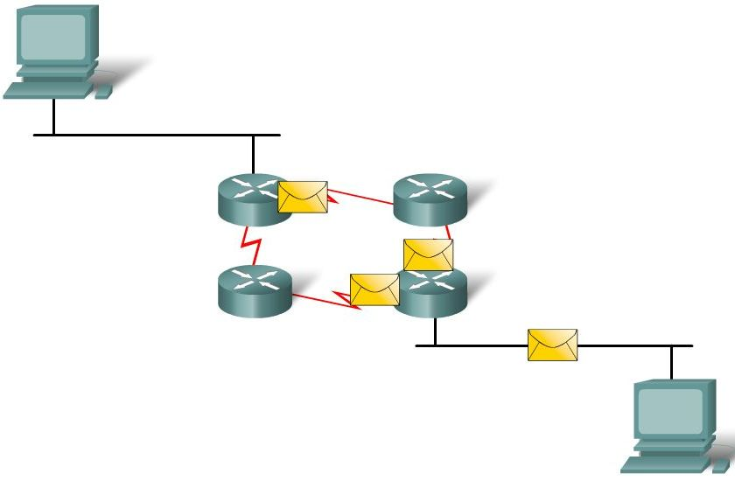
Router Paths and Packet Switching
Equal cost metric is a condition where a router has multiple paths to the same destination that all have the same metric
To solve this dilemma, a router will use Equal Cost Load Balancing. This means the router sends packets over the multiple exit interfaces listed in the routing table.

Slide 13
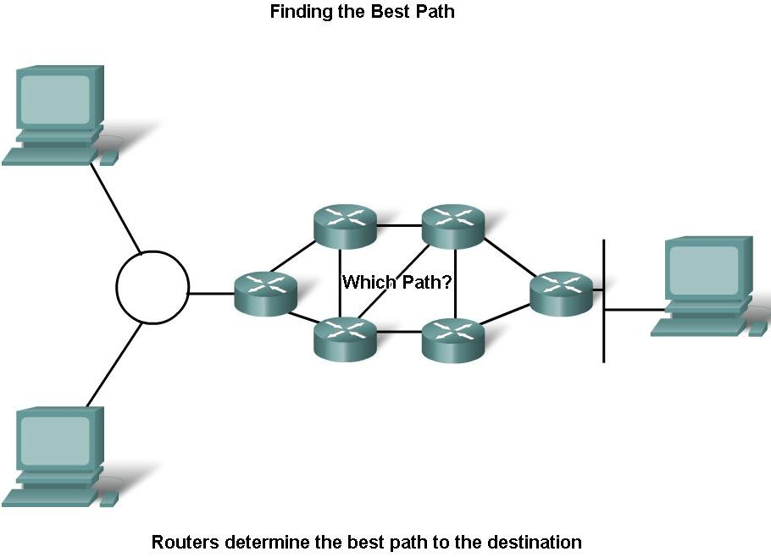
Router Paths and Packet Switching
Path determination is a process used by a router to pick the best path to a destination
One of 3 path determinations results from searching for the best path
  Directly connected network
  Remote network
  No route determined

Slide 14
Router Paths and Packet Switching
Switching Function of Router is the process used by a router to switch a packet from an incoming interface to an outgoing interface on the same router.
  -A packet received by a router will do the following:
        Strips off layer 2 headers.
        Examines destination IP address located in Layer 3 header to find best route to destination.
        Re-encapsulates layer 3 packet into layer 2 frame.
        Forwards frame out exit interface.

Slide 15
Router Paths and Packet Switching
As a packet travels from one networking device to another
  -The Source and Destination IP addresses NEVER change
  -The Source & Destination MAC addresses CHANGE as packet is forwarded from one router to the next.
  -TTL field decrement by one until a value of zero is reached at which point router discards packet (prevents packets from endlessly traversing the network)

Slide 16
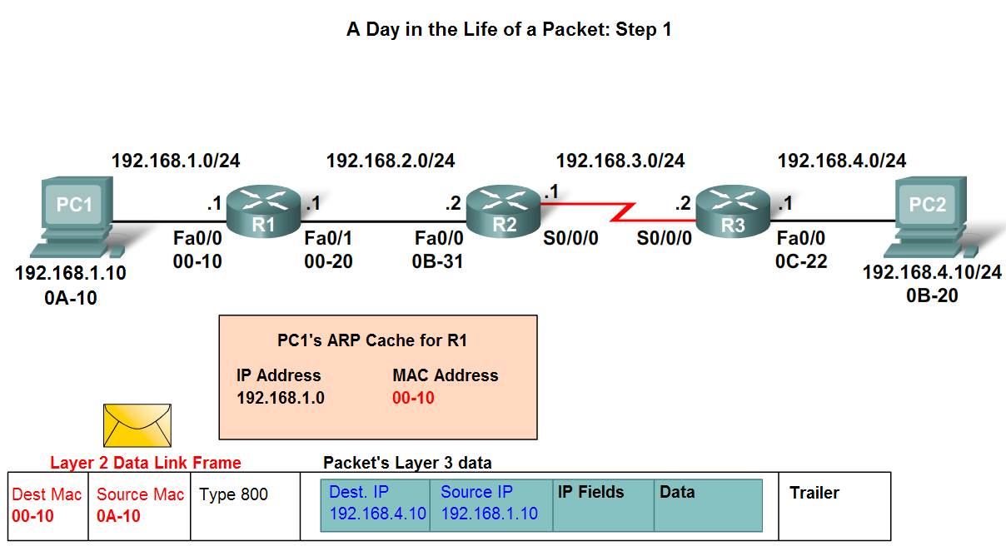
Router Paths and Packet Switching
Path determination and switching function details. PC1 Wants to send something to PC 2 here is part of what happens
  Step 1 - PC1 encapsulates packet into a frame. Frame contains R1’s destination MAC address

Slide 17
Router Paths and Packet Switching
  Step 2 - R1 receives Ethernet frame.
    R1 sees that destination MAC address matches its own MAC.
    R1 then strips off Ethernet frame.
    R1 Examines destination IP.
    R1 consults routing table looking for destination IP.
    After finding destination IP in routing table, R1 now looks up next hop IP address.
    R1 re-encapsulates IP packet with a new Ethernet frame.
    R1 forwards Ethernet packet out Fa0/1 interface.

Slide 18
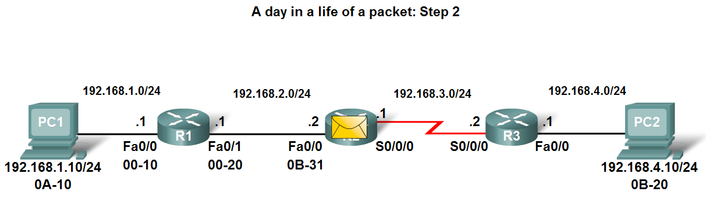
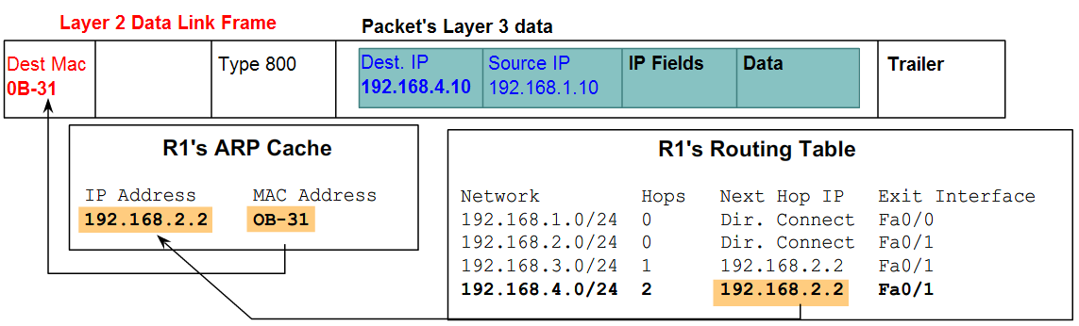
Router Paths and Packet Switching

Slide 19
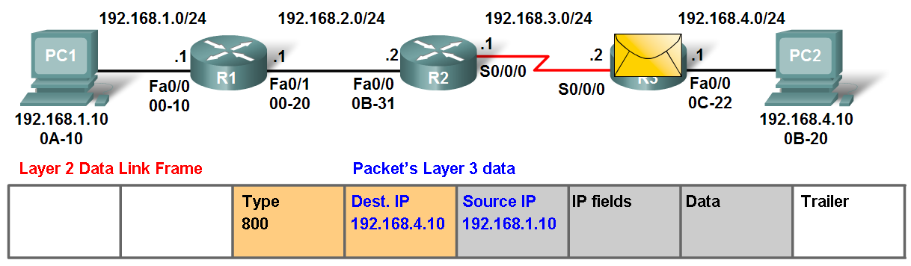
Router Paths and Packet Switching
Path determination and switching function details. PC1 Wants to send something to PC 2 here is part of what happens
  Step 3 - Packet arrives at R2
    R2 receives Ethernet frame
    R2 sees that destination MAC address matches its own MAC
    R2 then strips off Ethernet frame
    R2 Examines destination IP
    R2 consults routing table looking for destination IP
    After finding destination IP in routing table, R2 now looks up next hop IP address
    R2 re-encapsulates IP packet with a new data link frame
    R2 forwards Ethernet packet out S0/0 interface

Slide 20
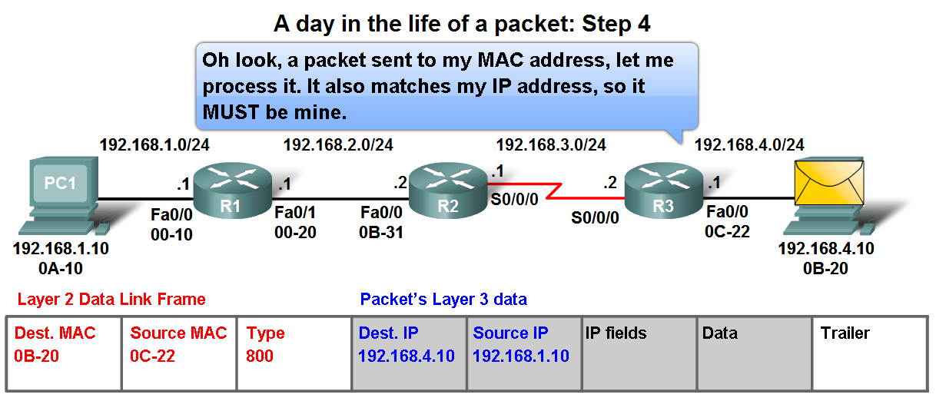
Router Paths and Packet Switching
Path determination and switching function details. PC1 Wants to send something to PC 2 here is part of what happens
  Step 4 - Packet arrives at R3
    R3 receives PPP frame
    R3 then strips off PPP frame
    R3 Examines destination IP
    R3 consults routing table looking for destination IP
    After finding destination IP in routing table, R3 is directly connected to destination via its fast Ethernet interface
    R3 re-encapsulates IP packet with a new Ethernet frame
    R3 forwards Ethernet packet out Fa0/0 interface
  Step 5 - IP packet arrives at PC2. Frame is decapsulated & processed by upper layer protocols.

